Slide 1

Effective expert search Ranking and presenting expert search results
Thomas Schoegje
Arjen de Vries, Lynda Hardman, Toine Pieters
Notes:
Thomas – work at municipality of Utrecht, part time phd
Lynda recently became involved with the project, and I was quite excited when she told me about a human-centered research group
Please interrupt me

Slide 2
Why expert search?
Notes:
In expert search the search results are people instead of documents
We are basically trying to help people search for other people with expertise

Slide 3
Why expert search?
The expert knows the relevant documents
The expert can contextualise data
The expert can give advice
The expert can help avoid redundant work
Faster than searching
Improving the Effectiveness and Efficiency of Web-based Search Tasks for Policy Workers,
Thomas Schoegje, Arjen de Vries, Lynda Hardman, Toine Pieters, 2023
Notes:
In previous work

Slide 4
Why expert search?
The expert knows the relevant documents
The expert can contextualise data
The expert can give advice
The expert can help avoid redundant work
Faster than searching
More complex tasks more likely to look for expertise
Improving the Effectiveness and Efficiency of Web-based Search Tasks for Policy Workers,
Thomas Schoegje, Arjen de Vries, Lynda Hardman, Toine Pieters, 2023
Notes:
In previous work

Slide 5
Overview
Why expert search?
How to (improve) search for experts?
Approach
Qualitative study
Quantitative study
Conclusion

Slide 6
How to search experts?
Model expertise Rank experts Present results
Notes:
Very high level we can consider three steps

Slide 7
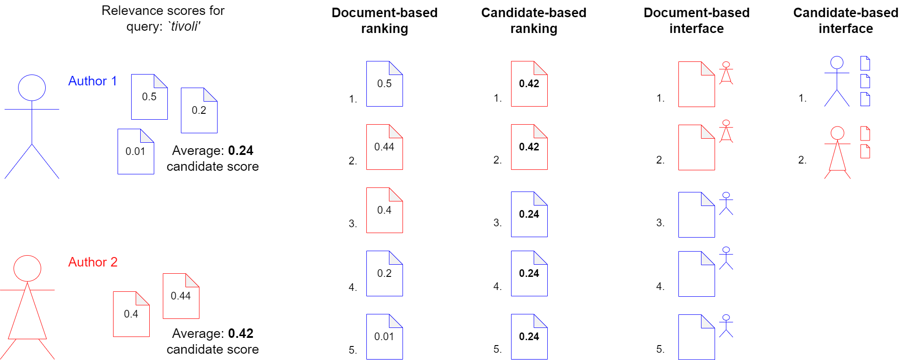
How to search experts?
Model expertise Rank experts Present results
Notes:
First we need to find some way to identify the experts, and link them to evidence of their expertise

Slide 8
How to search experts?
Model expertise Rank experts Present results
Notes:
Then, given a query, we need to rank our search results. This could be done by ranking our pieces of evidence

Slide 9
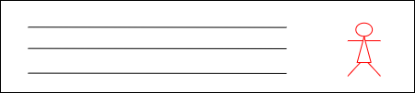
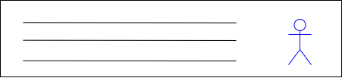
How to search experts?
Model expertise Rank experts Present results
Notes:
Finally, we present our results in the interface, and give users ways to interact with these results
Previous work in expert search has largely focused on these first two steps.

Slide 10
How to search experts?
Model expertise Rank experts Present results
Notes:
One very important question that was asked was: should we be modelling and ranking people, or documents?
Is it better when we rank by an overall model of expertise, or by pieces of evidence of their expertise?

Slide 11
How to search experts?
Model expertise Rank experts Present results
Notes:
One very important question that was asked was: should we be modelling and ranking people, or documents?
Is it better when we rank by an overall model of expertise, or by pieces of evidence of their expertise?
The main research question in our work applies this same principle to how we present our search results: should we present search results as people (with evidence attached), or as pieces of evidence (with the experts attached)
How is this going to affect how users evaluate results?

Slide 12
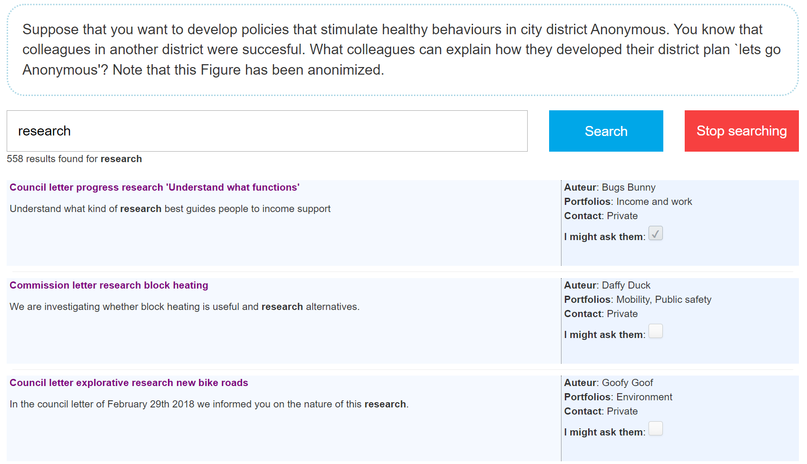
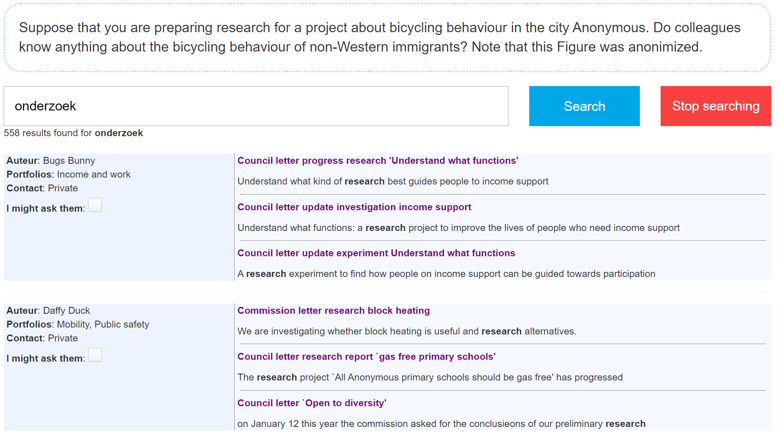
Document-based interface
Candidate-based interface
Notes:
Candidate experts
Can already get some clues from the experimental setup from these images,
For now I’ll just note that both interfaces contain the same information, and results, but present it differently

Slide 13
Main research questions
Are expert-centered or document-centered search results more useful for expert search tasks?
Notes:
Effectiveness, efficiency, user satisfaction
Quantitative aspect

Slide 14
Main research questions
Are expert-centered or document-centered search results more useful for expert search tasks?
Are there interaction effects between how we rank and how we present search results?

Slide 15
Main research questions
Are expert-centered or document-centered search results more useful for expert search tasks?
Are there interaction effects between how we rank and how we present search results?
(How) does the interface change affect how users search?
Notes:
There is also a qualitative aspect, it might affect how users evaluate search results. My search strategy might be different if I am trying to find a person, or

Slide 16
Overview
Why expert search?
How to (improve) search for experts?
Approach
Results: qualitative study
Results: quantitative study
Conclusion

Slide 17
Approach
Qualitative study using questionnaire
What system do participants prefer and why?
Quantitative study using simulated tasks
How does the system affect task performance?
(effectiveness, efficiency and user satisfaction)
Notes:
We’re going to start with the qualitative study, as it also gives context to our quantitative findings
Try to decide a way to model each task using a number of task facets
Then characterise tasks that we find through interviews, questionnaires and observation

Slide 18
Approach
Simulated search tasks adapted from real policy-worker tasks
4 combinations of 2 interface / 2 ranking types
Multiple systems with same interface confusing: ranking type as between-participants variable
Participants were novice users, as these need the most support
Notes:
Try to decide a way to model each task using a number of task facets
Then characterise tasks that we find through interviews, questionnaires and observation
New people in the organisation don’t know their way around yet and don’t have a network

Slide 19
Overview
Why expert search?
How to (improve) search for experts?
Approach
Results: qualitative study
Results: quantitative study
Conclusion

Slide 20
Qualitative results
Document-based interface
Candidate-based interface
Why do half the users prefer the first interface, and half the second?
Notes:
Support different search strategies
Which might be related to different preferences
Serialistic vs holistic cognitive styles
perhaps with expertise, there will be a dominant search strategy

Slide 21
Qualitative results
Why do half the users prefer the first interface, and half the second?
Document-based interface
Candidate-based interface
+ Simple / not too complex
+ Lets me first evaluate document,
then check contact info
+ Complete
+ Lets me first evaluate author,
then use documents as evidence
Notes:
Support different search strategies
Which might be related to different
Serialistic vs holistic cognitive styles

Slide 22
Qualitative results
The Interfaces support different information seeking strategies
We actually changed two variables between the interfaces: - Perceived information complexity - Perceived retrieval unit
Notes:
Specifically: amount of information

Slide 23
Qualitative results
The Interfaces support different information seeking strategies
We actually changed two variables between the interfaces: - Perceived information complexity - Perceived retrieval unit
Can we elicit desired behaviour through interface design?
Notes:
Specifically: amount of information

Slide 24
Overview
Why expert search?
How to search experts, and how to improve it?
Approach
Results: qualitative study
Results: quantitative study
Conclusion

Slide 25
Quantitative results
Metrics
Effectiveness: correct task completion
Efficiency: task completion time
Satisfaction: System Usability Scale (SUS) questionnaire
Variables
Interface type: candidate- or document-based
Ranking type: candidate- or document-based
Preferred system: interface-type the participant preferred
Notes:
The qualitative analysis suggested this is an important explanatory variable, so it would be interesting to see how this interacts with the other variables

Slide 26
Quantitative results
Ground truth (effectiveness)
Every author has sub-domains in their portfolio
Policy workers indicated which portfolios are relevant for each task
If an author has a relevant portfolio, we consider them relevant
Notes:
Specifically: amount of information

Slide 27
Quantitative results
Candidate-based interface significantly more correct task completion
Document-based ranking significantly faster task completion
Interaction effect between interface and ranking: cannot combine
Notes:
Specifically: amount of information

Slide 28
Quantitative results
Candidate-based interface significantly more correct task completion
Document-based ranking significantly faster task completion
Interaction effect between interface and ranking: cannot combine
Choice effectiveness / efficiency:
There is an unmeasured social cost + time cost in approaching the wrong expert. We believe an organization should prefer effectiveness
Notes:
We can affect how people search – slower evaluation
Specifically: amount of information
In the longer term, we should find a way to combine the strengths of both, but the tested versions are incompatible.

Slide 29
Conclusion
Notes:
Try to decide a way to model each task using a number of task facets
Then characterise tasks that we find through interviews, questionnaires and observation

Slide 30
Conclusion
Expert search is frequently useful 59% of queries to Sharepoint are about people (Lykke et al. 2022)
Half of policy worker tasks involve finding people (Schoegje et al. 2023)
Candidate-based search interfaces elicit slow and more effective search behaviour
The system’s design affects how users will perceive and interact with information
Does more effectiveness outweigh the preferences of half the users?
Notes:
If we change how the system looks and works, it will affect how users interact with that system
Can raise some interesting questions – even in our work we chose for a more effective interface, but it was at odds with the preferences of half the users

Slide 31
Conclusion
Expert search is frequently useful 59% of queries to Sharepoint are about people (Lykke et al. 2022)
Half of policy worker tasks involve finding people (Schoegje et al. 2023)
Candidate-based search interfaces elicit slow and more effective search behaviour
Notes:
If we change how the system looks and works, it will affect how users interact with that system
Can raise some interesting questions – even in our work we chose for a more effective interface, but it was at odds with the preferences of half the users

Slide 32
Conclusion
Expert search is frequently useful 59% of queries to Sharepoint are about people (Lykke et al. 2022)
Half of policy worker tasks involve finding people (Schoegje et al. 2023)
Candidate-based search interfaces elicit slow and more effective search behaviour
The system’s design affects how users will perceive and interact with information
Does more effectiveness outweigh the preferences of half the users?
Notes:
If we change how the system looks and works, it will affect how users interact with that system
Can raise some interesting questions – even in our work we chose for a more effective interface, but it was at odds with the preferences of half the users

Slide 33

Conclusion
Contact: t.schoegje@utrecht.nl
Notes:
There are many approaches we can take to designing information systems, and it can be hard to choose one
We found that a task-based approach to design helps us invest into features that provide value to our users
We also found that the council members at multiple municipalities have the same search tasks. So even if there are different datasets underlying those systems, it seems plausible that we could work together towards better common search tools. That’s kind of encouraging to me, because I think shared goals and resources can get more fundamental solutions than separated initiatives
TODO bring it back together

